Slide 1


International Conference on Science, Mathematics, Environment,and Education (ICoSMEE)
On the Run-Length of the Structural Change in Time Series Data
by
Wiwik Prihartanti
Dwilaksana Abdullah Rasyid
Nur Iriawan

Slide 2
INTRODUCTION

Slide 3

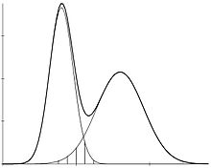
INTRODUCTION
Notes:
The movement of changes in serial data is often only seen as a series of data that changes following a uni-modal pattern. In fact, because of the mechanism of the process of occurring data in the field, data patterns often have to be in the form of multi-modal
One of the appropriate modeling methods is to involve the mixture distribution to capture the nature of the multi-modality patterns of the data

Slide 4
METHODOLOGY

Slide 5
MAIN IDEA
Structural Change Modeling
Mixture Model
Markov Switching Model
Run Length Distribution

Slide 6
MARKOV SWITCHING MODEL for STOCK PRICE
The probability transition matrix
Markov Switching Autoregressive model
Notes:
To estimate the parameter we use MLE, but in Markov processes, unfortunately, determining the number of states is a hidden step in the process of estimating MSwM. Ordinary likelihood ratio tests may not be fulfilled

Slide 7
Expectation and Maximisation
Expectation Stage
Maximisation Stage

Slide 8
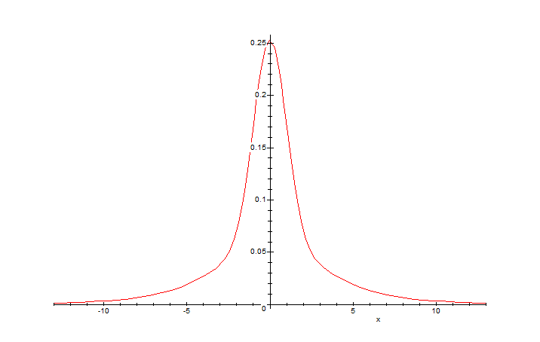
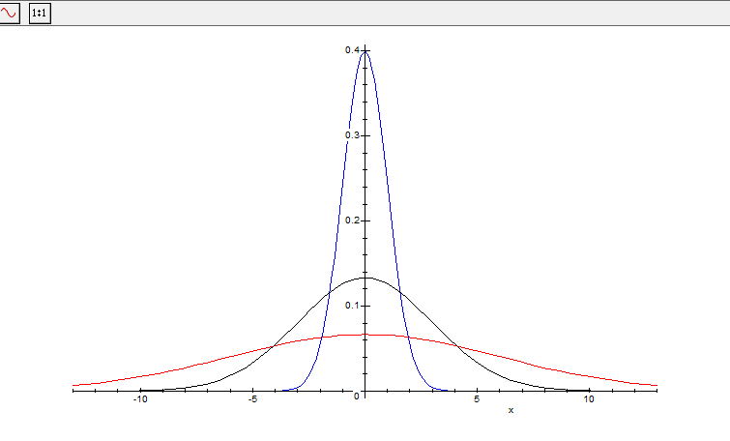
Mixture Distribution
if the series is at difference
but it must be in mixture distribution
Notes:
In this case we have to use Augmented Diggie Fuller test to make sure if this series is stationary
But diggie fuller test not testing if the series have two or more distribution
In that case we should have use MATEMATICA software to make sure

Slide 9
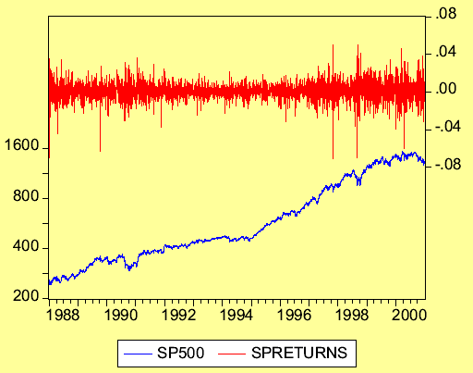
Mixture Distribution
1
2
1
Switching
Volatility Regime
2
Switching
Mean Regime
1

Slide 10
AVERAGE RUN LENGTH in MARKOV SWITCHING MODEL (MsWM)
Originally, for the Shewhart chart, ARL can be calculated as
ARL = 1 / p
where p is the probability that any one point exceeds the control limit.
Calculating a run length in the regime switching process, it can be done by exploiting the estimation process of the MSwM model incorporated with the EM algorithm in it.

Slide 11



Data Sources and Research Variables
PT. Indofood Sukses Makmur Tbk. (INDF.JK)
PT. Indofood CBP Sukses Makmur Tbk. (ICBP.JK)
PT. Mustika Ratu Tbk. (MRAT.JK),
Close price starts from the date of IPO in each company
End in April 12, 2019 from Yahoo Finance
Notes:
, the three consumers good shares that entered as members of the LQ45

Slide 12
RESULT AND DISCUSSION

Slide 13
TERASVIRTA LINEARITY TEST
Company | Chi-Square | df | p­-value | Decision
INDF.JK | 13,648 | 2 | 0,001088 | Reject H₀
ICBP.JK | 6,3668 | 2 | 0,04144 | Reject H₀
MRAT.JK | 35,731 | 2 | 1.742 x 10⁻⁸ | Reject H₀
The results of the Terasvirta linearity test indicate that the closing data of three company is. not linear

Slide 14
ARL for INDFI.JK
Company | Statictics | Regime 1 | Regime 2
INDF.JK | Maximum of Run Length | 215 | 465
 | Minimum of Run Length | 1 | 1
 | Sum of Run Length | 151 | 151
 | Average of Run Length | 17,1391 | 13,7815
Run Length Histogram

Slide 15
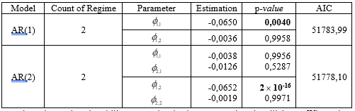
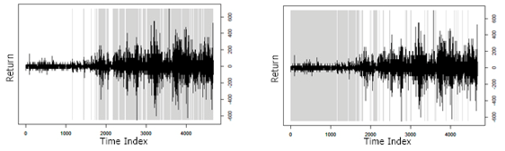

MSwM-AR for INDFI.JK

Slide 16

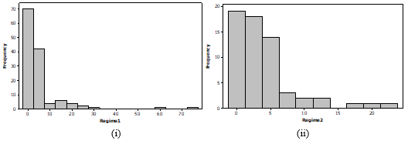
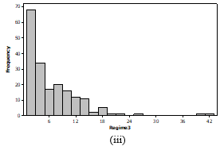
ARL for ICBP.JK
Run Length Histogram

Slide 17
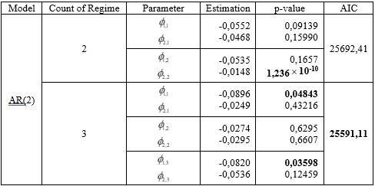

MSwM-AR for ICBP.JK

Slide 18

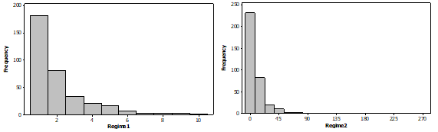
ARL for MRAT.JK
Run Length Histogram

Slide 19
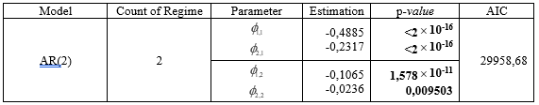

MSwM-AR for MRAT.JK

Slide 20
CONCLUSION

Slide 21
Conclusion
From the 3 consumer goods companies shows that IDNF.JK will be selected for stock planting because the monitoring process at this company tends to be easy. In addition, the process of moving the company's shares from regime 1 to regime 2 has a long time.

Slide 22
References
Britama.com: Daftar Saham dalam Indeks LQ-45 Mulai dari Agustus 2003 hingga Sekarang, http://britama.com/index.php/2016/03/daftar-saham-dalam-indeks-lq-45-mulai-dari-agustus-2003-hingga-sekarang/, downloaded at April 10, 2019
Hamilton, J.D. Specification Testing in Markov-switching Time Series Models. Journal of Econometrics, 1996, 70: 127-157.
Kim, C.J and Nelson C.R. State Space Models with Regime Switching, Classical and Gibbs Sampling Approaches with Applications. Cambridge, MA: MIT Press. 1999
Persio, L.D. and Frigo, M. Gibbs sampling approach to regime switching analysis of financial time series, Journal of Computational and Applied Mathematics, 2016, 300, 43–55, DOI: 10.1016/j.cam.2015.12.010.
Dempster, A.P., Laird, N.M. and Rubin, D.B., Maximum likelihood from incomplete data via the EM algorithm (with discussion). Journal of the Royal Statistical Society Series B, 1977, 39, 1-38. DOI: 10.1.1.133.4884.
Frühwirth-Schnatter, S. Finite Mixture and Markov Switching Models, Springer, New York. 2006.
Chuffart, T. Selection Criteria in Regime Switching Conditional Volatility Models, Econometrics, 2015, 3, 289-316. DOI:10.3390/econometrics3020289.
Huang, X., Xu, N., and Bisgaard, S. (2013) A Class of Markov Chain Models for Average Run Length Computations for Autocorrelated Processes, Communications in Statistics - Simulation and Computation, 42:7, 1495-1513, DOI: 10.1080/03610918.2012.667474
Weisstein, E.W. "Normal Distribution." From MathWorld--A Wolfram Web Resource. http://mathworld.wolfram.com/NormalDistribution.html, downloaded on March 20, 2019.
Berk, K., Hoffmann, A., and Müller, A. Probabilistic Forecasting of Industrial Electricity Load with Regime Switching Behavior, International Journal of Forecasting, 2018, 34, 147–162. DOI: 10.1016/j.ijforecast.2017.09.006.

Slide 23
International Conference on Science, Mathematics, Environment,and Education (ICoSMEE)
On the Run-Length of the Structural Change in Time Series Data
by
Wiwik Prihartanti
Dwilaksana Abdullah Rasyid
Nur Iriawan

